Slide 3



Slide 4



Slide 5



Slide 6



Slide 7


Slide 8


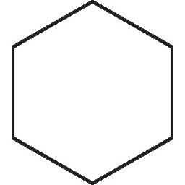






Slide 9
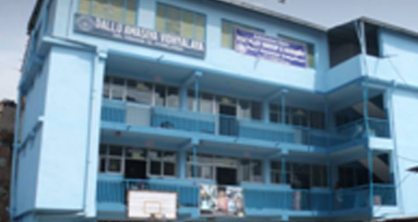
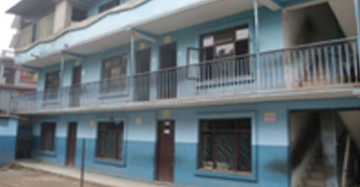





Dallu Awasiya Vidyalaya
Dallu, Kathmandu-15
Education for Excellence

Slide 10


<>
</>

Slide 11



Slide 12



